Slide 1
Unit Test Basic
Part -1
“Tests are stories we tell the next generation of programmers on a project.” ― Roy Osherove

Slide 2
Understand the Testing Pyramid
Small tests are unit tests that you can run in isolation from production systems. They typically mock every major component and should run quickly on your machine.
Medium tests are integration tests that sit in between small tests and large tests. They integrate several components, and they run on emulators or real devices.
Large tests are integration and UI tests that run by completing a UI workflow. They ensure that key end-user tasks work as expected on emulators or real devices.

Slide 3
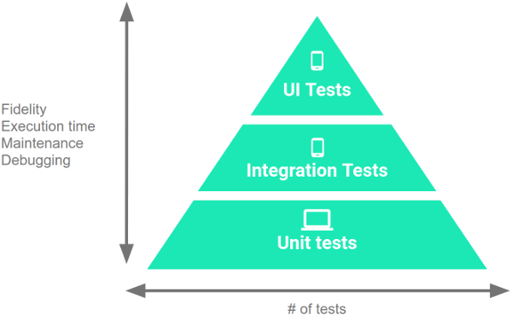
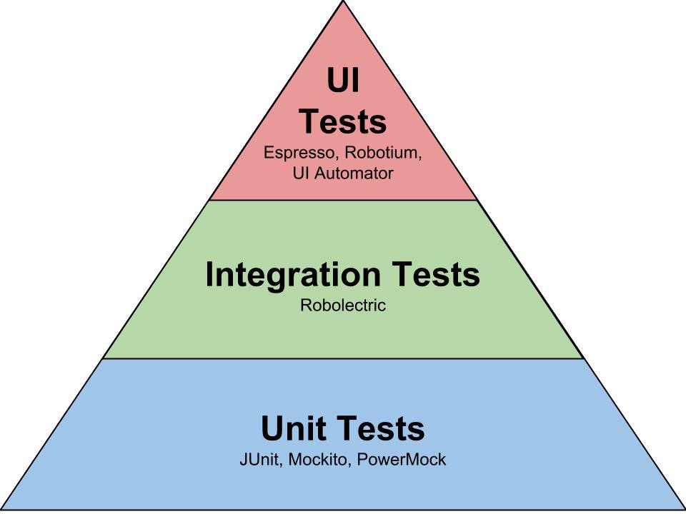
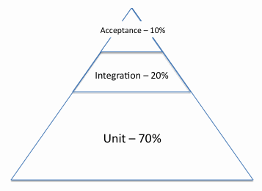
Understand the Testing Pyramid (Cont..)
What to test on Android applications

Slide 4
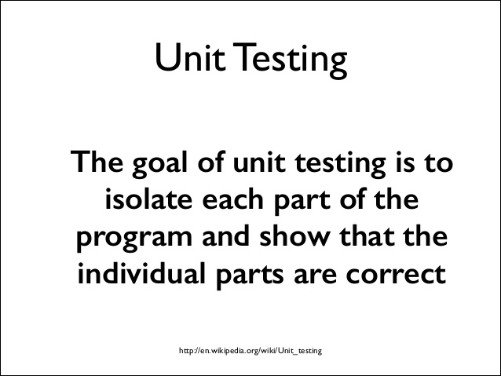
Unit test

Slide 5
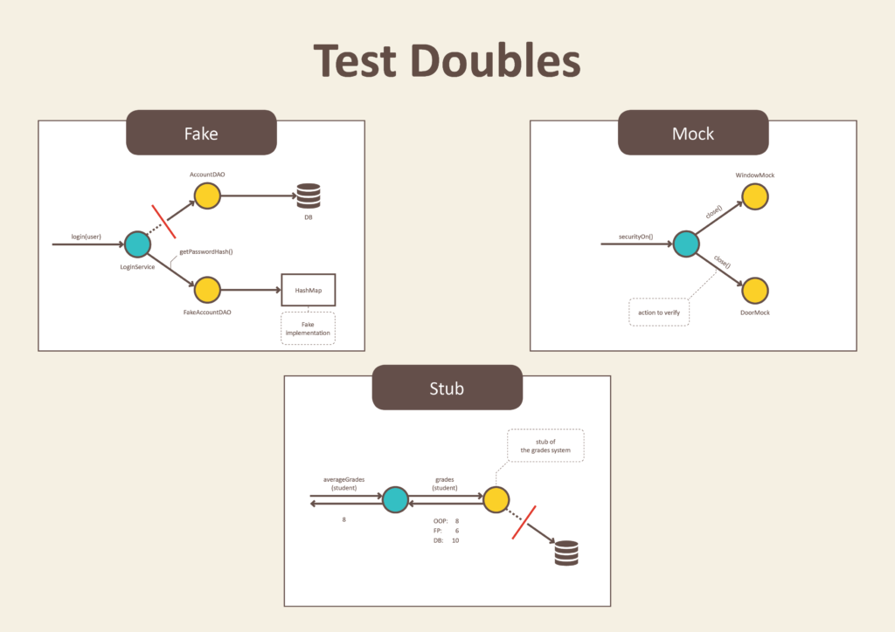
Test Doubles
A test double is an object that can stand in for a real object in a test
Similar to how a stunt double stands in for an actor in a movie.
The most common types of test doubles
are stubs, mocks, and fakes.

Slide 6
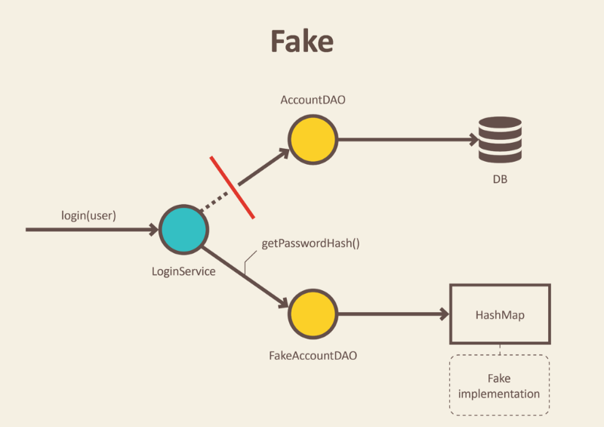
Fake
Fakes are objects that have working implementations, but not same as production one. Usually they take some shortcut and have simplified version of production code.
Fakes can be used when you can't
use a real implementation in your
test. (e.g. if the real implementation
is too slow or it talks over the
network).

Slide 7
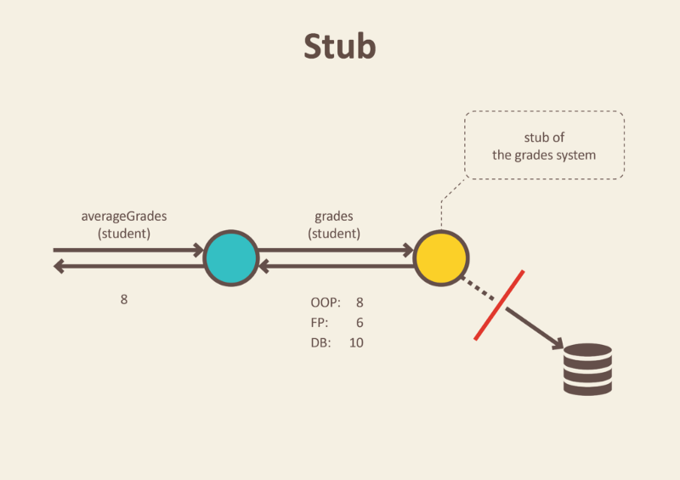
Stub
Stub is an object that holds predefined data and uses it to answer calls during tests. It is used when we cannot or don’t want to involve objects that would answer with real data or have undesirable side effects.
A stub has no logic, and only returns
what you tell it to return. Stubs can
be used when you need an object to
return specific values in order to get
your code under test into a certain
state.

Slide 8
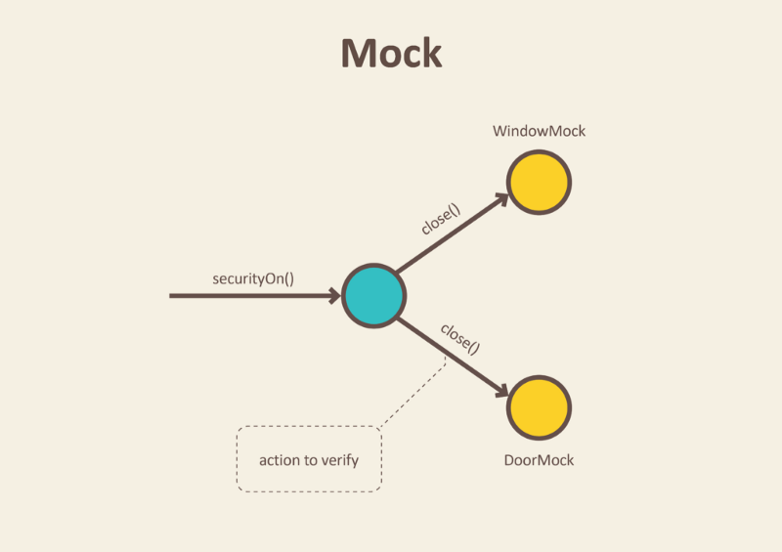
Mock
We use mocks when we don’t want to invoke production code or when there is no easy way to verify, that intended code was executed.
We don’t want to send e-mails each time we run a test.
Moreover, it is not easy to verify
in tests that a right email was send.
Only thing we can do is to verify the
outputs of the functionality that is
exercised in our test. In other worlds,
verify that e-mail sending service was called.

Slide 9
Collaborator Object
A Collaborator Object is a unit of code whose responsibility is to orchestrate the invocation of other units.
It is common in unit tests to mock or stub collaborators of the class under test so that the test is independent of the implementation of the collaborators.

Slide 10
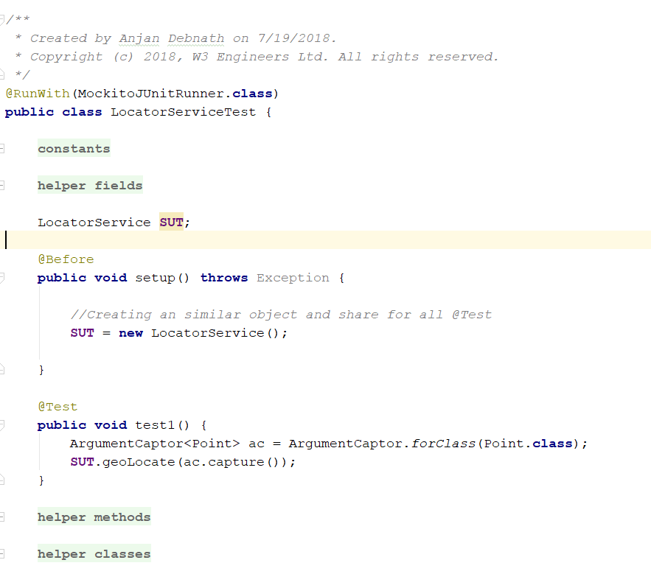
Coding pattern

Slide 11
Unit test name pattern
<unitOfWork>_<stateUnderTest>_<expectedBehaviour>
unitOfWork = Method Name
stateUnderTest = what is testing
expectedBehaviour = return value of the test
When properly named unit test fails, you can investigate and fix the issue without reading unrelated source code.

Slide 12

Argument Captor
Use it to capture argument values for further assertions.
Mockito verifies argument values in natural java style: by using an equals() method.

Slide 13
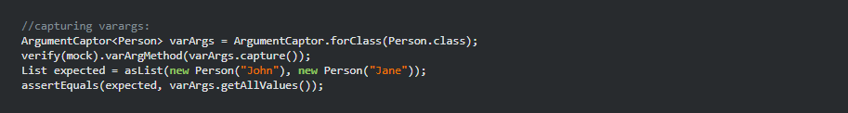
Argument Captor
it is recommended to use ArgumentCaptor with verification but not with stubbing.
Using ArgumentCaptor with stubbing may decrease test readability because captor is created outside of assert (aka verify or 'then') block.

Slide 14
When and Then
when(listMock.add(anyString())).thenReturn(false);
use when(mock).thenReturn(value) to specify the stub value for a method.
when(listMock.add(anyString())).thenReturn(false);

Slide 15
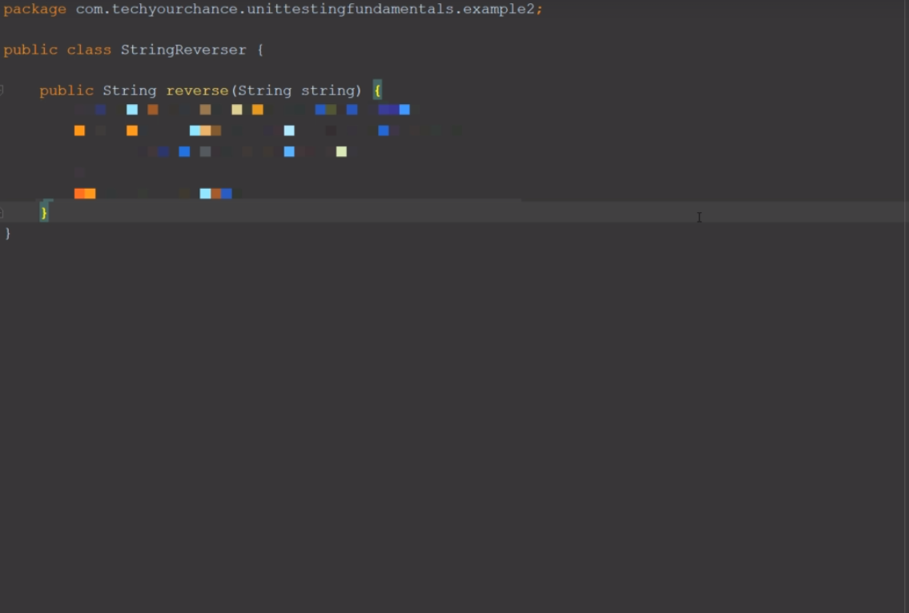
Example

Slide 16
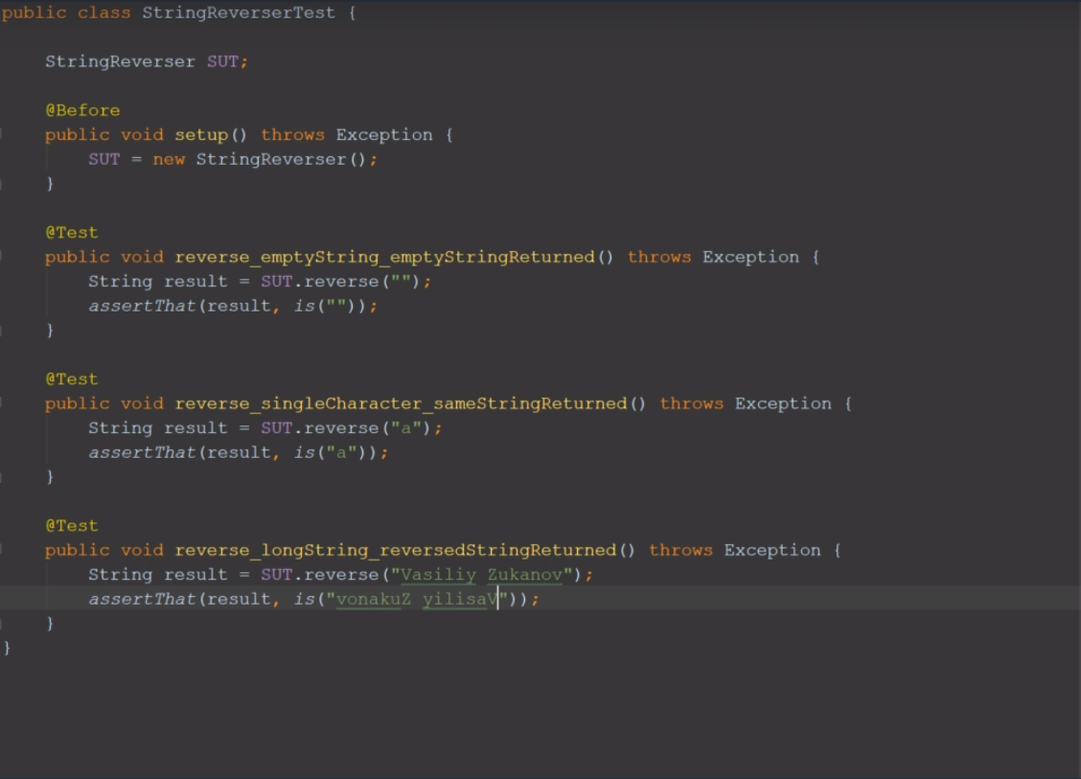
Example

Slide 17


Test Driven Development (TDD)
Uncle Bob’s 3 rules for TDD

Slide 18

Thanks…

